Slide 1


EXCEL VBA
Data Entry Form
Presented By : Ashish Sawant

Slide 2
1
OVERVIEW
Introduction
UserForm 1: Login
UserForm 2: Main Menu
UserForm 3: Customer Entry
UserForm 4: Inventory Entry
Thank You
Excel VBA

Slide 3

2
INTRODUCTION
Greetings,
Today, I'm excited to introduce our new project, a comprehensive Excel VBA application designed to streamline and enhance data management processes.
This project leverages the power of Visual Basic for Applications (VBA) to create intuitive user interfaces, automate calculations, and facilitate seamless integration with external systems.
Let's delve into the key components of this project:
Excel VBA

Slide 4
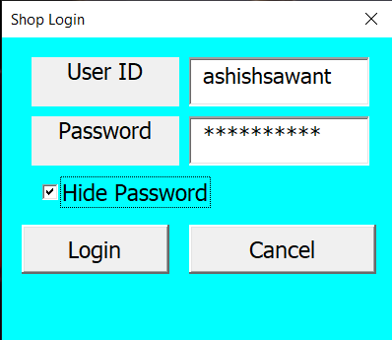
3
USERFORM 1: LOGIN
UserForm 1 serves as the gateway to accessing the Excel files and initiating the application.
It features fields for entering login credentials, ensuring secure access to sensitive data.
By providing a seamless login experience, users can effortlessly connect to the system and unlock its full potential.
Excel VBA

Slide 5
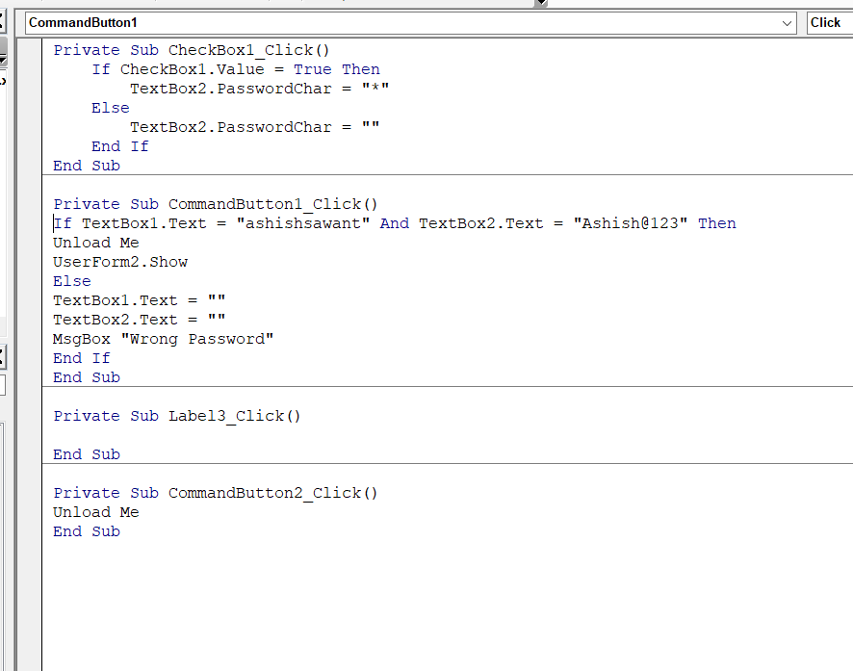
4
Excel VBA

Slide 6
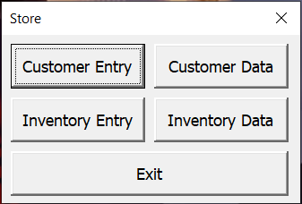
5
USERFORM 2: MAIN MENU
UserForm 2 acts as the central hub of the application, offering a diverse range of functionalities through an intuitive menu interface.
Users can conveniently navigate through various options such as customer entry, inventory management, and file selection.
This versatility empowers users to tailor their experience according to their specific needs, fostering efficiency and flexibility.
Excel VBA

Slide 7
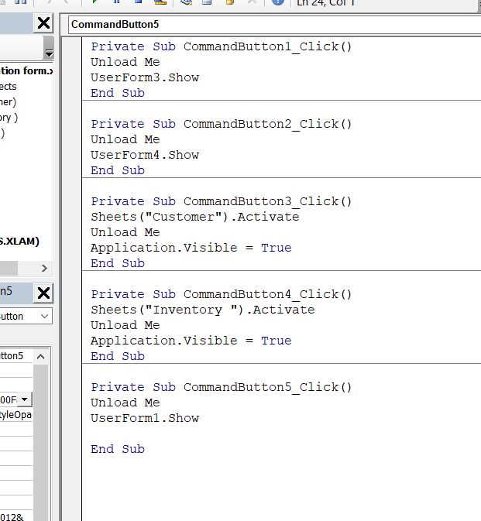
6
Excel VBA

Slide 8
7
USERFORM 3: CUSTOMER ENTRY
UserForm 3 revolutionizes the process of capturing customer data by providing a user-friendly interface with automatic calculation capabilities.
Through carefully designed input fields and intuitive controls, users can effortlessly input customer information while the system handles calculations in real-time.
This not only expedites data entry but also minimizes errors, ensuring data accuracy and reliability.
Excel VBA

Slide 9
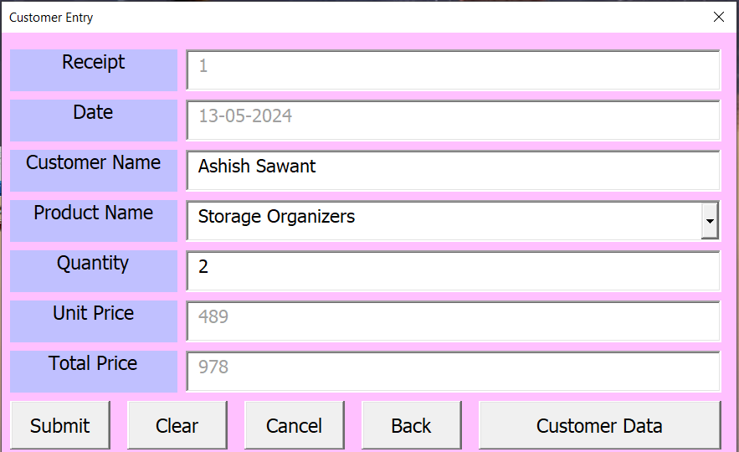
USERFORM 3: CUSTOMER ENTRY
8
Excel VBA

Slide 10
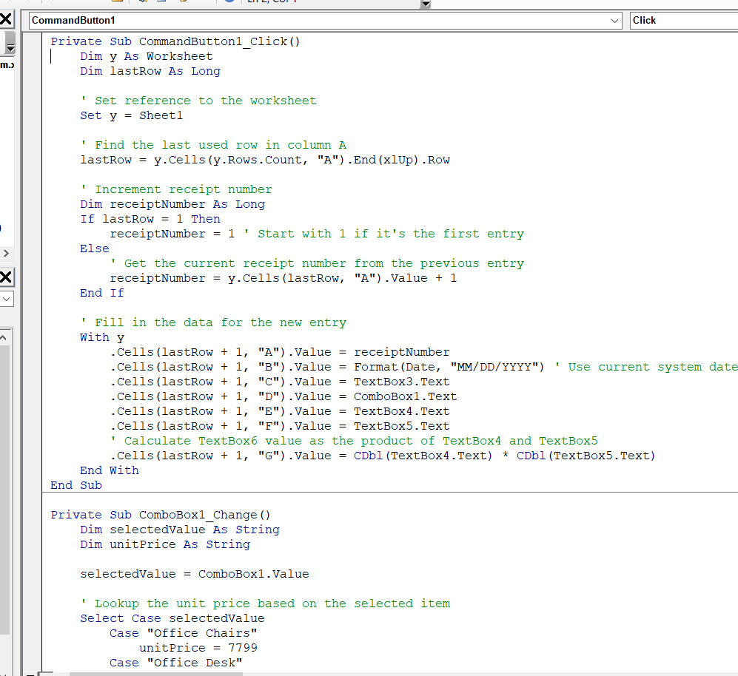
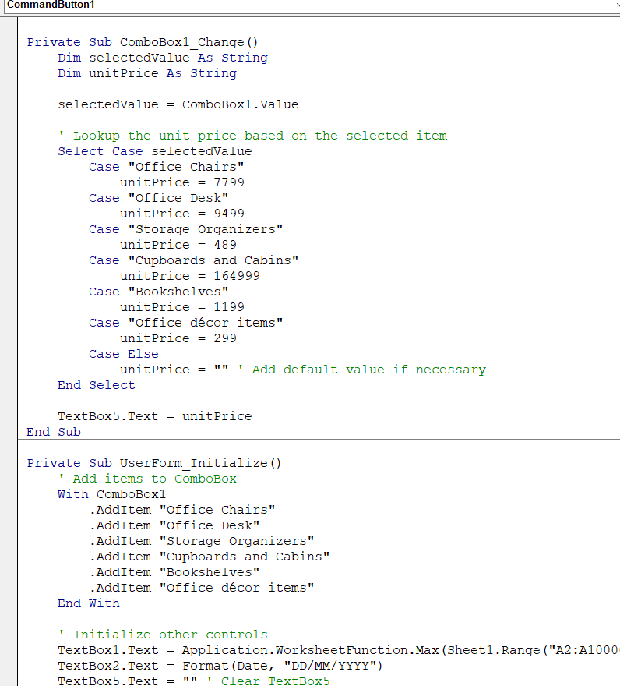
9
Excel VBA

Slide 11
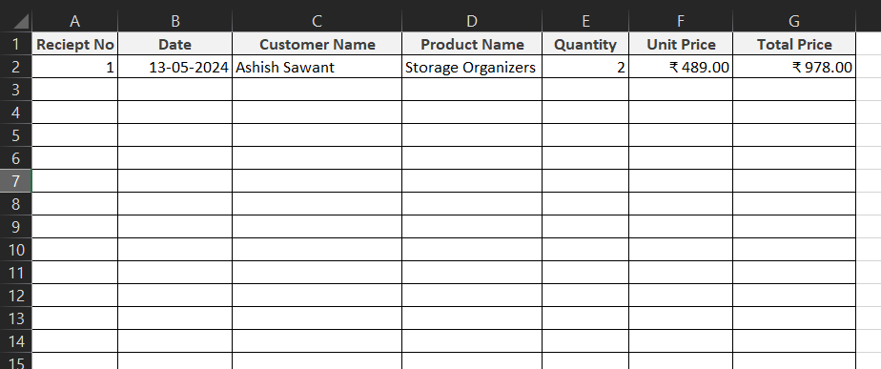
10
USERFORM 3: SHEET
Excel VBA

Slide 12
11
USERFORM 4: INVENTORY ENTRY
UserForm 4 simplifies inventory management by offering a streamlined interface for entering inventory data.
Equipped with automatic calculation features, this userform empowers users to efficiently record inventory details while the system performs calculations seamlessly.
By automating mundane tasks and providing instant feedback, UserForm 4 enhances productivity and accuracy in inventory management processes.
Excel VBA

Slide 13
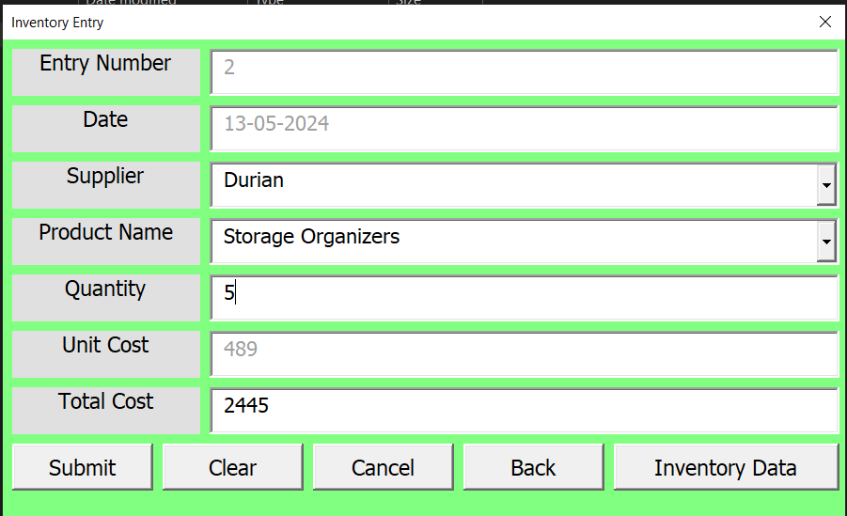
12
USERFORM 4: INVENTORY ENTRY
Excel VBA

Slide 14
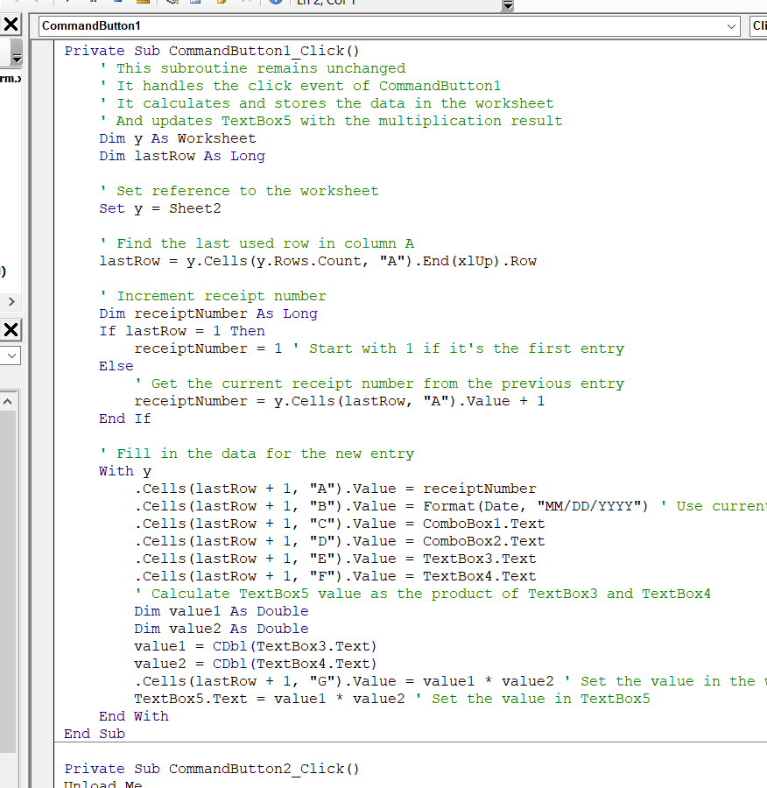
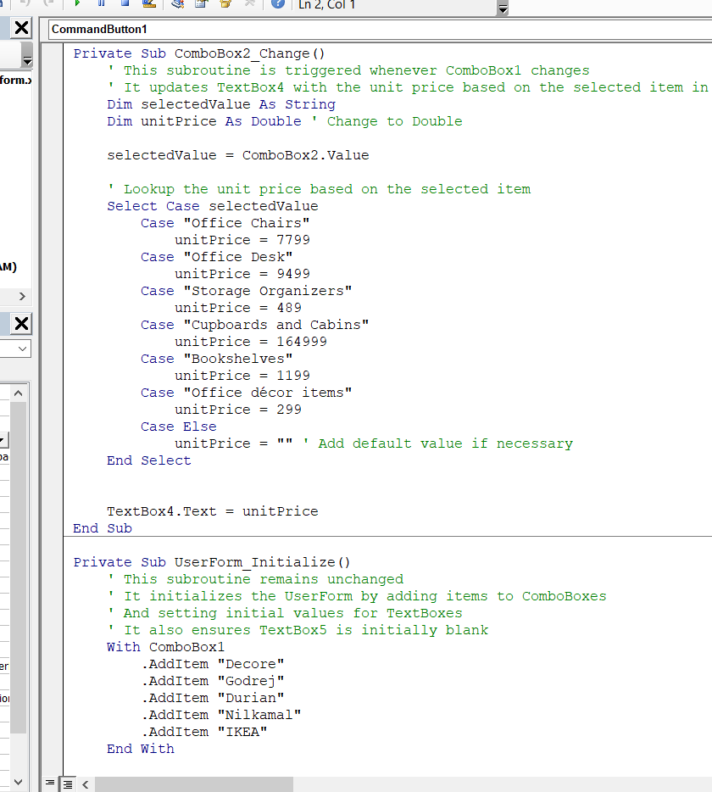
13
Excel VBA

Slide 15
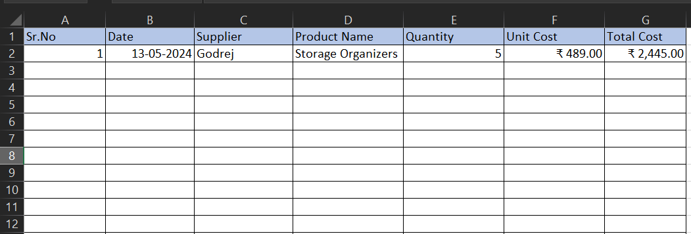
13
USERFORM 4: SHEET
Excel VBA

Slide 16
Excel VBA
THANK YOU
Presented By : Ashish Sawant

